Slide 1
Epi 510: Data management in Stata III

Slide 2
cd C:/epi510/stata/data
use "gbdChildMortalityData.dta", clear

Slide 3
Indexing: big-n, little-n

Slide 4
_n the number of the current observation
_N the total number of observations in the dataset
Notes:
_n = index, where you current are
_N = constant, how many observations there are

Slide 5
See what happens when you type
generate n = _n
generate N = _N
browse n N

Slide 6
3
broad approaches:
if
in
by
Notes:
By allows us to repeat a command for each group of observations that have the same values of variables in the variables that you specify.

Slide 7
by repeats command for each group of observations having the same values of variables in varlist*
by varlist: stata_cmd
data must be sorted by varlist
*
help by
Notes:
“This command is byable” – the by prefix will work
Data must be sorted by variables in varlist

Slide 8
If data are already sorted by region…
by region: summarize neoMR
Otherwise…
sort region
by region: summarize neoMR
or…
bysort region: summarize neoMR
help by

Slide 9
bysort region: summarize neoMR if year>=2000
Notes:
In r, you’d have to do either tapply or tidyverse dplyr group by command. This is a good feature of stata to work for longitudinal measures (ex: looking by patient over time)

Slide 10
Exercise

Slide 11
Use tabstat to produce summary statistics of neonatal mortality by year if year>=2000. Add a bysort prefix to the above command to create separate tables for each region containing summary statistics of neonatal mortality by year.
Notes:
tabstat neoMR if year >=2000, by(year) stat (n mean sd min p25 p50 p75 max)
bysort region: tabstat neoMR if year >=2000, by(year) stat (n mean sd min p25 p50 p75 max)

Slide 14
[by varlist:] command [varlist] [=exp][if exp][in range] [weight][, options]
by varlist:
optionally repeat command by values of variables in varlist

Slide 15
See what happens when you type
bysort country (year): gen countryIndex = _n
bysort country: gen countryN = _N
browse country* year
Notes:
bysort country (year): gen countryIndex = _n – sort by country and year, and repeat this index by country (not by year)
bysort country: gen countryN = _N – total number of observations for a country (when combined with bysort, normally big N is total number of observations total)

Slide 16
tabulate countryN if countryN==countryIndex
countryN | Freq. Percent Cum.
------------+-----------------------------------
20 | 1 0.53 0.53
38 | 1 0.53 1.07
41 | 185 98.93 100.00
------------+-----------------------------------
Total | 187 100.00
Notes:
CountryN = country Index on the last row of data for a country
-we have 41 years of data for 185 countries, and so on.

Slide 17
What do you think this will do?
bysort country (year): gen firstYear = _n==1
tab year firstYear
Notes:
_n = 1 – expression will be true for the year of data that is the first year of data for a country, the others will be false (identifying a patient’s first visit, for example)

Slide 18
tabulate year if firstYear==1
Year | Freq. Percent Cum.
------------+-----------------------------------
1970 | 185 98.93 98.93
1973 | 1 0.53 99.47
1991 | 1 0.53 100.00
------------+-----------------------------------
Total | 187 100.00

Slide 19
Alternatively…
bysort country: egen minYear = min(year)
generate firstYear = minYear==year
Notes:
Will find minimum year by country

Slide 20
Exercise

Slide 21
Create a new variable that contains the total number of under-five deaths by country.
Create a variable that contains the number of observations by country (hint: we did this a few minutes ago)
Replace the total under-five mortality variable (created above) with missing if a country has fewer than 41 years of data (i.e. < 41 observations)

Slide 23
Saving temporary versions of your data

Slide 24
preserve preserves the current dataset for automatic restoration after program termination
help preserve
Notes:
Can only have a single preserve

Slide 25
restore Forces an immediate restoration of a preserved dataset
help restore

Slide 26
tempfile Assigns a name to be used for a temporary file
help tempfile
Notes:
More flexible option to preserve --

Slide 27
tempfile pop save `pop’ use otherfile.dta, clear do something use `pop’, clear
help tempfile
Notes:
Unbalanced quotes surrounding pop – the one on the left is in the upper left of keyboard, then standard single quote on righthand side

Slide 28
Which to use?
preserve/restore
You can only preserve a single dataset
You can't access a preserved dataset within a command (e.g. you can't merge a preserved dataset to the dataset currently in memory)
Very quick and convenient
Use cases: backing up before attempting a destructive command; quick dataset switching
tempfile
Number of datasets limited only by computer hardware
Accessible within a command
Less quick and convenient
Use cases: managing multiple datasets within a single script or analysis
Notes:
Tempfile only exists when and where it’s created

Slide 29
On disappearing preserves and tempfiles…

Slide 30
“
”
tempfile assigns names to the specified local macro names that may be used as names for temporary files. When the program or do-file
concludes, any datasets created with these assigned names are erased.
- Stata help file

Slide 31
Combining datasets

Slide 32
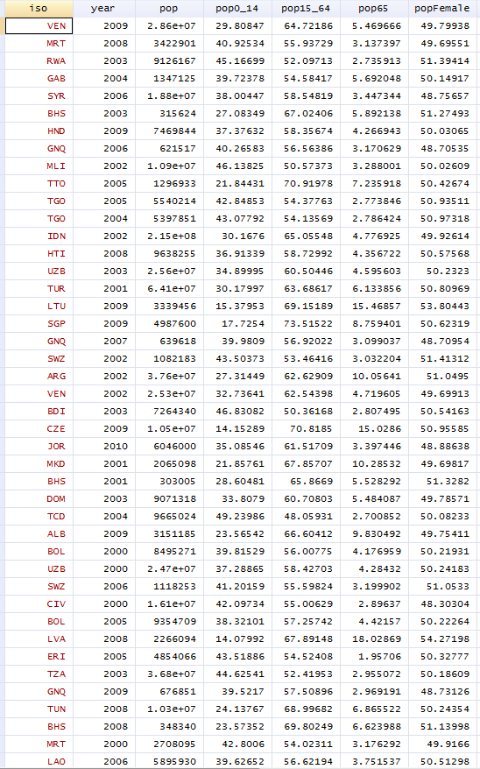
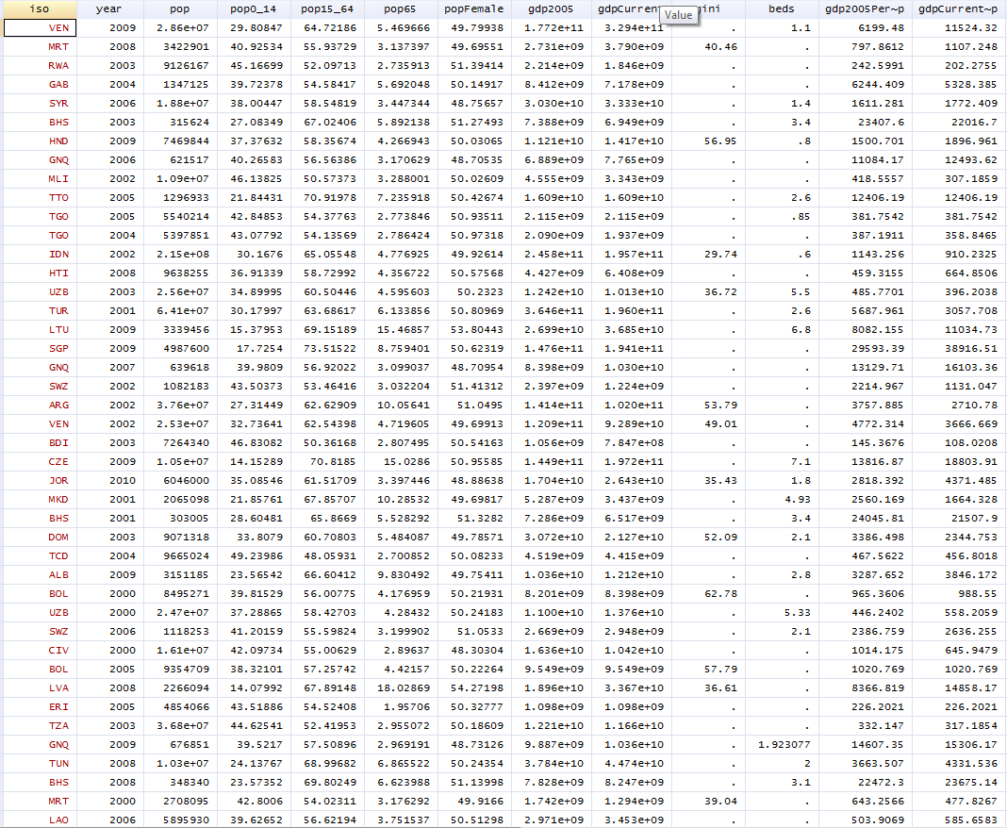
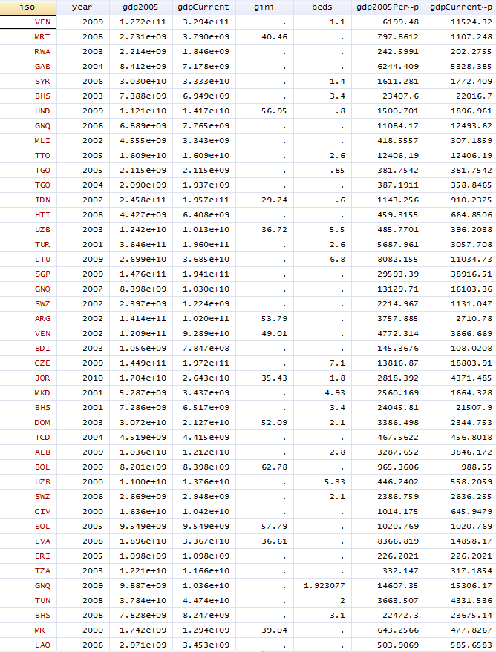
merge
=
+
help merge
Notes:
Adding columns = merge

Slide 33
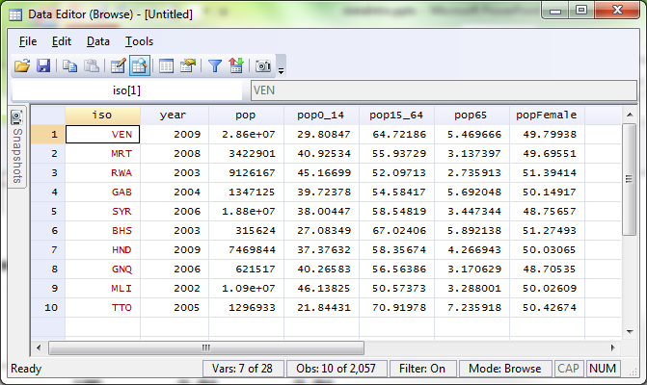
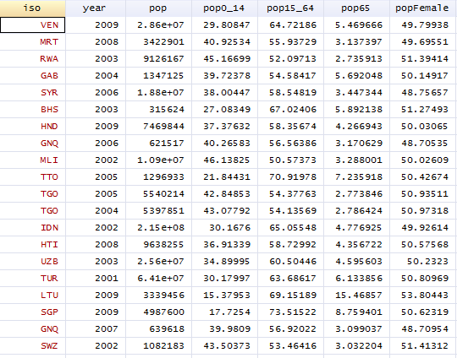
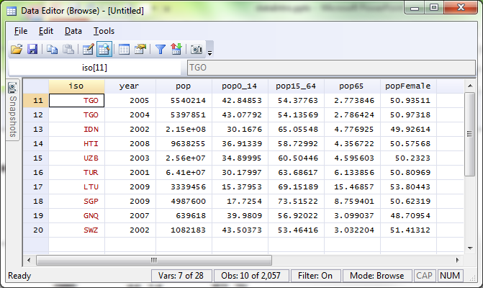
append
+
=
Notes:
Adding rows is an append (in r it would be an rbind)

Slide 34
append combine datasets by adding observations that correspond to existing variables
help append

Slide 35
append using worldBankCountryIndicators1970-99.dta

Slide 36
There are five GBD Child Mortality datasets, each covering one decade:
gbdChildMortality_1970s.dta
…
gbdChildMortality_2010s.dta
Append these five datasets to make a single dataset comprising data from 1970 through 2010, inclusive

Slide 38
merge combine datasets by adding variables that correspond to existing observations
help merge

Slide 39
unique id variables
1:1, 1:m, m:1 or m:m
dataset to merge in
>
>
>
merge 1:1 iso year using "hExp+oop.dta“
Result # of obs.
-----------------------------------------
not matched 0
matched 7,643 (_merge==3)
-----------------------------------------

Slide 40
Exercise

Slide 41
Starting with the appended child mortality dataset you created in the previous exercise:
Merge in worldBankCountryIndicators.dta
Merge in worldBankCountryInfo.dta

Slide 43
Useful options for merge generate(varname) nogenerate keep(results) e.g. keep(match) or keep(match master) assert(results) e.g. assert(match) or assert(match master)
help merge

Slide 44
Reconfiguring datasets

Slide 45
collapse convert current dataset into a dataset of summary statistics
help collapse

Slide 46
Example: create a dataset of the total number of deaths in each country
collapse (sum) *Deaths, by(country)

Slide 47
Example: create a dataset of the total number of deaths, and mean mortality rates, by country
collapse (sum) *Deaths (mean) *MR, by(country)

Slide 48
Exercise
Create a dataset of the totals for all death variables, and the means for all mortality rate variables, by GBD region for the first decade of this century (i.e. 2000 – 2009).

Slide 50
reshape convert data between wide and long forms
help reshape

Slide 51
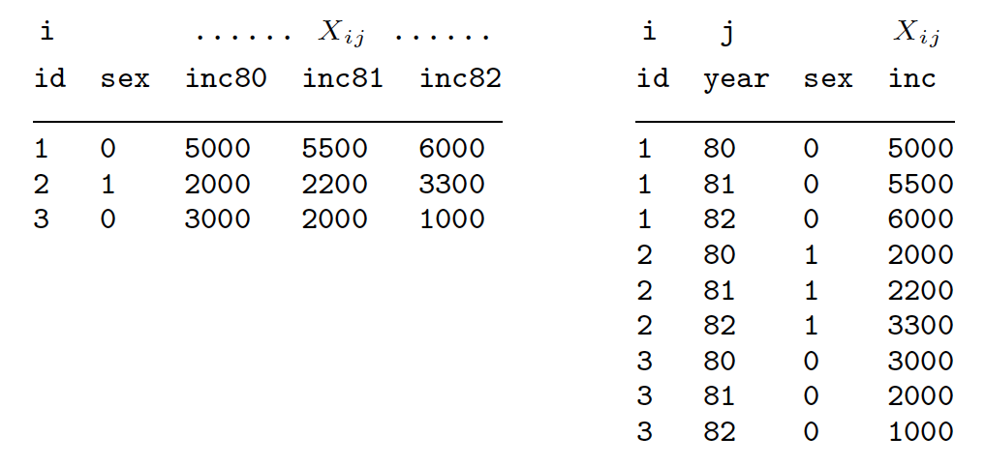
wide form
long form

Slide 52
reshape long inc, i(id sex) j(year) // from left to right
reshape wide inc, i(id sex) j(year) // from right to left

Slide 53
long
+------------+ wide
| i j stub | +----------------+
|------------| | i stub1 stub2 |
| 1 1 4.1 | reshape |----------------|
| 1 2 4.5 | <---------> | 1 4.1 4.5 |
| 2 1 3.3 | | 2 3.3 3.0 |
| 2 2 3.0 | +----------------+
+------------+
To go from long to wide: j existing variable
/
reshape wide stub, i(i) j(j)
To go from wide to long:
reshape long stub, i(i) j(j)
\
j new variable

Slide 54
Exercise

Slide 55
keep iso country gbdRegion year neoMR

Slide 56
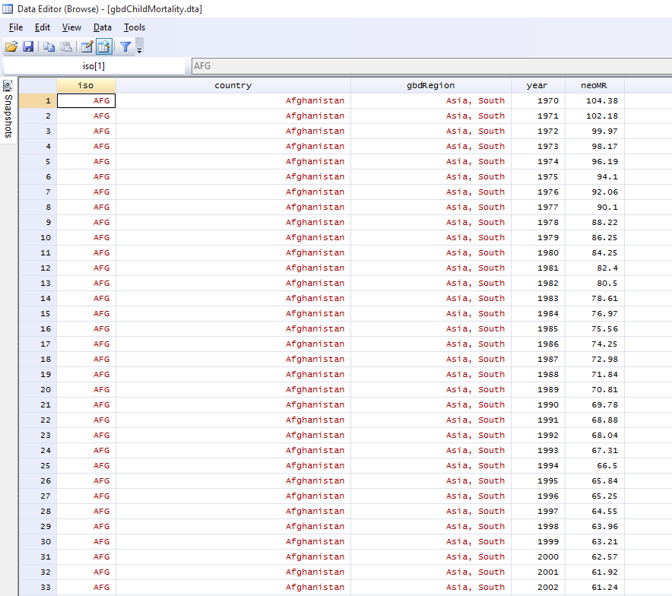

Slide 57
Convert this to wide form so there is a separate variable for neoMR by year
Hints:
You are reshaping neoMR to wide
year is the j-variable
All other variables are i-variables
reshape wide stub, i(i) j(j)

Slide 59
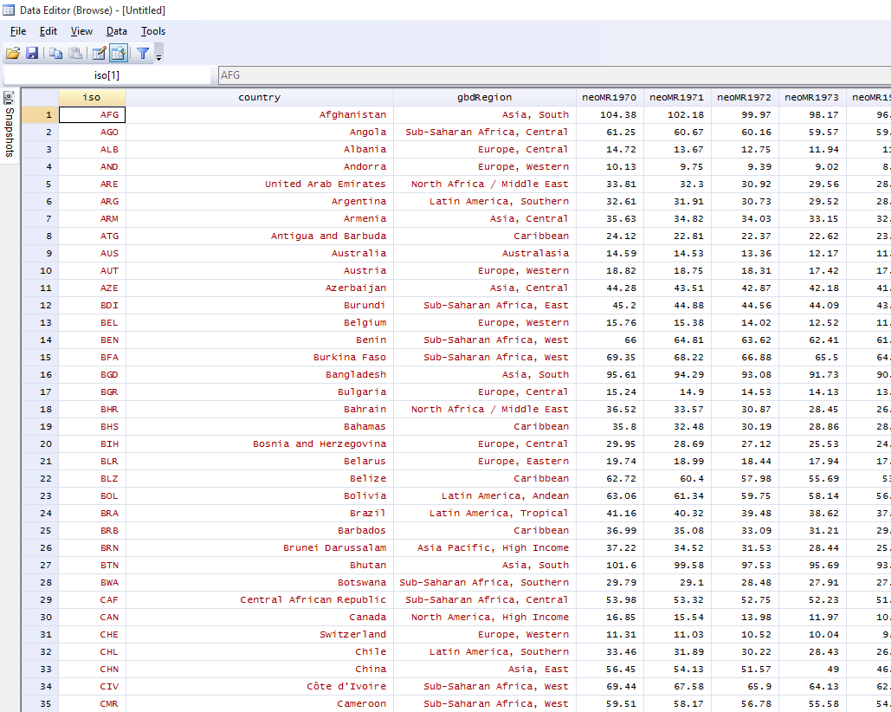

Slide 60
reshape long neoMR, i(iso-gbdRegion) j(year)

Slide 61
Questions?

